Slide 1
Real-Time Audio Noise Classifier
and Adaptive Filter System
Muhammad Qasim (2023488)
Muhammad Hammad (2023420)
Department of Computer Engineering, GIKI
1

Slide 2
Project Overview: Building a Smarter Audio System
Our project delivers a robust real-time system for audio recording, sophisticated noise classification, and adaptive filtering. This system is meticulously engineered to address prevalent audio interference challenges, ensuring clearer sound reproduction.
1
2
Module 1: Noise Identification
Module 2: Adaptive Noise Filtering
Focuses on accurately detecting and categorizing various types of ambient noise present in live audio streams.
Employs dynamic filtering techniques tailored to the identified noise, providing effective real-time suppression.
2

Slide 3



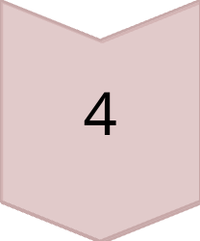


Comprehensive System Workflow
The system operates through a carefully designed sequence of steps, from audio capture to filtered output, ensuring optimal noise reduction and enhanced clarity.
1. Audio Recording
Capture live audio input using an integrated microphone.
2. Preprocessing
Normalize and preprocess the raw audio signal for analysis.
3. Feature Extraction
Extract key time and frequency domain characteristics.
4. Noise Classification
Identify the specific type of noise present in the audio.
5. Adaptive Filtering
Apply an appropriate filter based on the classified noise type.
6. Output & Visualization
Display and play the filtered audio, along with visual results.
3

Slide 4
Precision Audio Acquisition Parameters
High-fidelity audio capture is foundational to effective noise processing. Our system adheres to industry-standard specifications to ensure accurate signal representation.
44.1KHz
Mono
16-bit
Sampling Frequency
Channel Configuration
Bit Resolution
Ensures high-resolution digital audio capture, preserving signal integrity.
Simplified single-channel input for focused noise analysis and processing.
Provides a wide dynamic range, capturing subtle audio nuances.
Audio data is consistently acquired in 5-second segments using the powerful audiorecorder object in MATLAB, facilitating real-time analysis and processing.
4

Slide 5
Signal Normalization for Consistent Processing
Signal normalization is a critical preprocessing step that standardizes audio input, ensuring consistent and predictable behavior of subsequent filtering algorithms.
DC Offset Removal
Amplitude Normalization
The mean value is subtracted from the signal, effectively eliminating any direct current bias and centering the waveform around zero.
Signals are scaled to a standardized range of [-1, 1], preventing clipping and optimizing filter performance.
Stable Filter Behavior
Explicit Silence Detection
This process guarantees that the adaptive filters operate within expected parameters, leading to more reliable noise reduction across diverse audio inputs.
Dedicated mechanisms are in place to accurately detect periods of silence, preventing erroneous noise classification during quiet intervals.
5

Slide 6
Feature Extraction: Unveiling Audio Characteristics
To accurately classify noise, both time-domain and frequency-domain features are extracted. These features provide a comprehensive acoustic signature of the audio signal.
Frequency-Domain Analysis: Fast Fourier Transform (FFT)
Transforms the signal from the time domain to the frequency domain.
Allows for the identification of dominant frequencies and spectral content.
.
A single-sided magnitude spectrum is computed to represent positive frequencies.
A corresponding frequency axis is generated for precise analysis and visualization.
Six

Slide 7
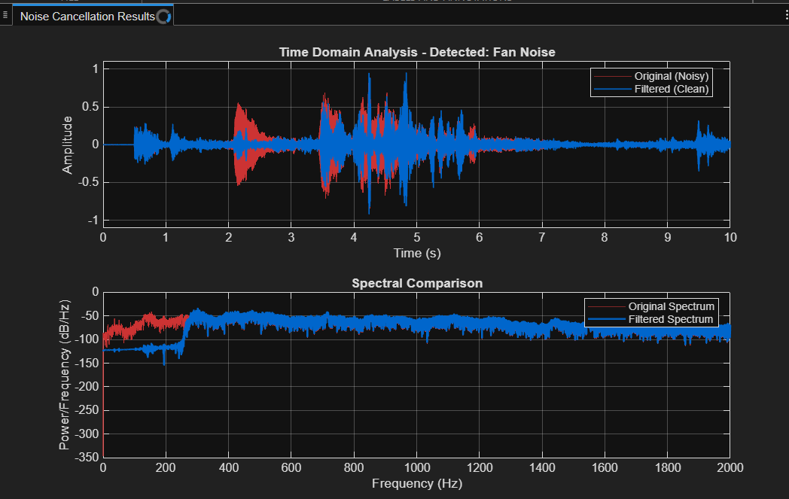
Output of The Time Domain

Slide 8
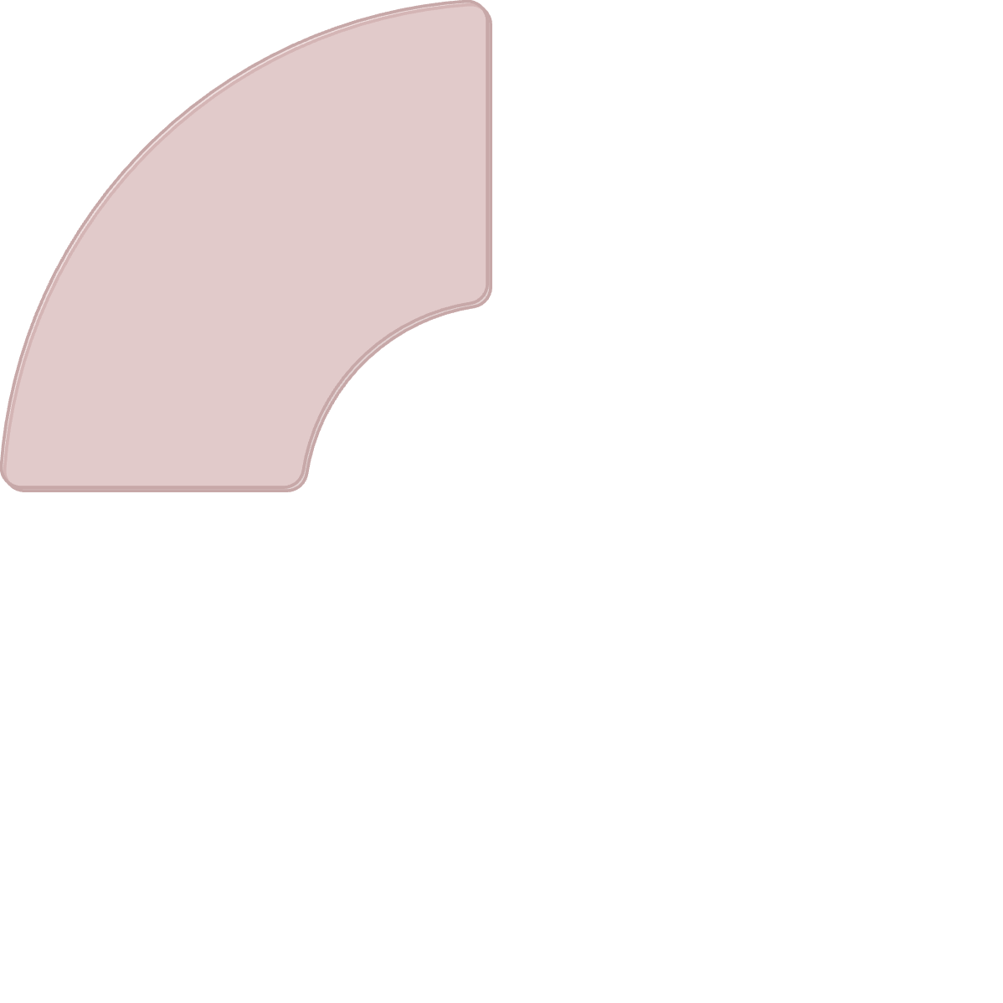



Spectral Centroid: Locating Energy Concentration
The spectral centroid is a fundamental descriptor of a sound's timbre, providing insight into where the "center of mass" of its spectrum lies. This helps differentiate various noise types.
Calculation
What it is
Computed as the weighted average of the frequencies present in the sound, with their magnitudes as the weights.
The spectral centroid is a measure used in digital signal processing to characterize a spectrum.
1
2
Low Centroid
High Centroid
Typically associated with lower-frequency noises like wind or engine hum, which have more energy concentrated in the bass frequencies.
Characteristic of sounds with more high-frequency content, such as speech or broadband noise.
4
3
Seven

Slide 9
Band Power Analysis: Dissecting Noise Frequencies
To effectively classify noise, the total signal power is segmented and analyzed across specific frequency bands. This allows for the identification of characteristic energy distributions associated with different noise types.
100%
45-65 Hz
Total Signal Power
Hum Band
The overall energy contained within the entire audio spectrum, serving as a baseline for band power ratios.
Specifically targets the common electrical hum frequency, crucial for identifying mains interference.
20-300 Hz
300-3400 Hz
Low-Frequency Band
Mid-Frequency (Speech) Band
Captures bass-heavy sounds like traffic rumble, wind gusts, or low-frequency machinery noise.
Encompasses the primary frequency range of human speech, essential for speech-related noise identification.
8

Slide 10
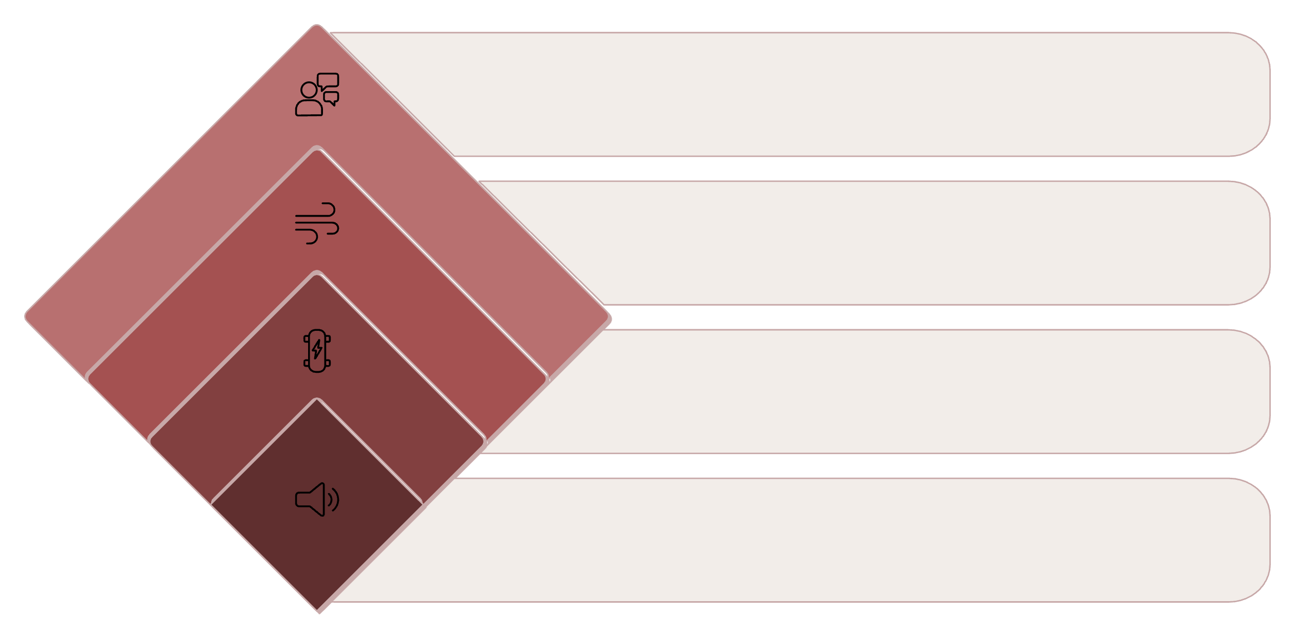




Noise Classification Logic: A Threshold-Based Decision Tree
Our system employs a sophisticated threshold-based decision tree that leverages computed power ratios across different frequency bands to accurately classify various noise types.
Power Ratio: Mid
Check mid-frequency ratio
Power Ratio: Low
Check low-frequency ratio
Power Ratio: Hum
Check hum-band threshold
Is there sound?
Detect presence of audio
This structured approach allows for robust categorization of noise, with debug values outputted to ensure transparency and aid in system verification.
Nine

Slide 11
Classification Output & Adaptive Filtering Integration
Upon classification, the identified noise label is presented to the user, directly informing the subsequent noise reduction strategy. This seamless integration ensures optimal filter selection.
1
2
3
Command Window Display
User Verification Pause
Filter Selection
The final noise label (e.g., "Silence," "Hum," "Traffic") is clearly displayed in the command window for immediate feedback.
A brief pause is incorporated, allowing users to verify the classification before proceeding to the filtering stage.
The classified noise type directly dictates the selection of the most appropriate adaptive filter within the second module of the system.
This ensures that the filtering process is precisely tailored to the specific noise encountered, maximizing effectiveness and audio clarity.
10

Slide 12
Noise Classification Logic
1
2
Frequency Band Power Ratios
Threshold-Based Decision Tree
Power ratios are meticulously computed across predefined frequency bands. This granular analysis forms the foundational data for subsequent classification, ensuring robust feature extraction from the audio input.
A meticulously designed decision tree, utilizing empirically derived thresholds, processes these power ratios. This structured approach ensures accurate and efficient categorization of diverse noise types, enhancing system responsiveness.
3
4
Diverse Noise Categories
Transparent Debugging
The system precisely identifies and classifies audio into distinct categories: silence, hum, chatter, wind, traffic, and fan noise. This comprehensive classification enables targeted and effective noise reduction strategies.
Critical debug values are continuously printed to the console, providing unparalleled transparency into the classification process. This facilitates real-time monitoring, troubleshooting, and validation of the system's decision-making logic.
11

Slide 13

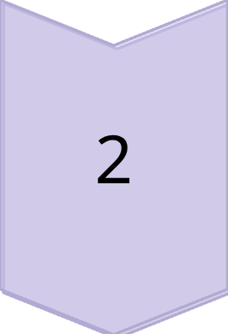

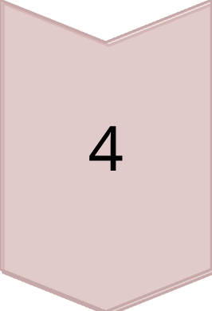
Fixed Filter Techniques
Notch Filter: Electrical Hum
A precisely tuned notch filter effectively eliminates persistent 50 Hz electrical hum, a common artifact in many audio environments. This ensures a clean baseline for further signal processing.
High-Pass Filter: Traffic/Engine Noise
A robust high-pass filter targets and attenuates low-frequency traffic and engine noise. This selectively removes rumble and drone, preserving clarity in desired audio components.
Band-Stop Filter: Fan & Broadband Noise
A versatile band-stop filter is employed to suppress fan and other broadband noise. This addresses a range of unwanted frequencies, enhancing the overall signal-to-noise ratio without excessive signal degradation.
Band-Pass Filter: Human Speech
A dedicated band-pass filter isolates and enhances the human speech spectrum. By focusing on critical vocal frequencies, it improves intelligibility in challenging acoustic environments.
12

Slide 14


NLMS Adaptive Filter for Wind Noise
Normalized Least Mean Squares (NLMS)
Delayed Reference Signal
The NLMS algorithm dynamically adjusts filter coefficients, offering an efficient and computationally stable solution for real-time adaptive noise cancellation.
Utilizing a carefully delayed reference signal, the filter effectively captures and models the wind noise characteristics, enabling precise subtraction from the primary audio stream.
Adaptive Weight Update
Effective Against Non-Stationary Wind Noise
The filter employs an adaptive weight update mechanism that ensures rapid convergence and sustained stability, even in rapidly changing noise environments, preventing divergence or instability.
This adaptive approach is particularly potent against the unpredictable and non-stationary nature of wind noise, providing superior performance compared to static filtering methods.
13

Slide 15



Visualization for Noise Reduction Effectiveness
Time-Domain Comparison
Frequency-Domain Analysis
Verification of Noise Reduction
Direct comparison of the original and filtered signals in the time domain provides intuitive visual evidence of noise reduction. Observe the attenuation of noise components and the preservation of desired signal characteristics post-filtering.
A periodogram-based frequency-domain comparison clearly illustrates the spectral impact of noise reduction. This visualization highlights the targeted removal of specific noise frequencies, confirming filter efficacy.
These comprehensive visualizations collectively verify the system's effectiveness. Engineers can quantitatively and qualitatively assess how well the noise components have been suppressed, leading to improved audio quality.
14

Slide 16
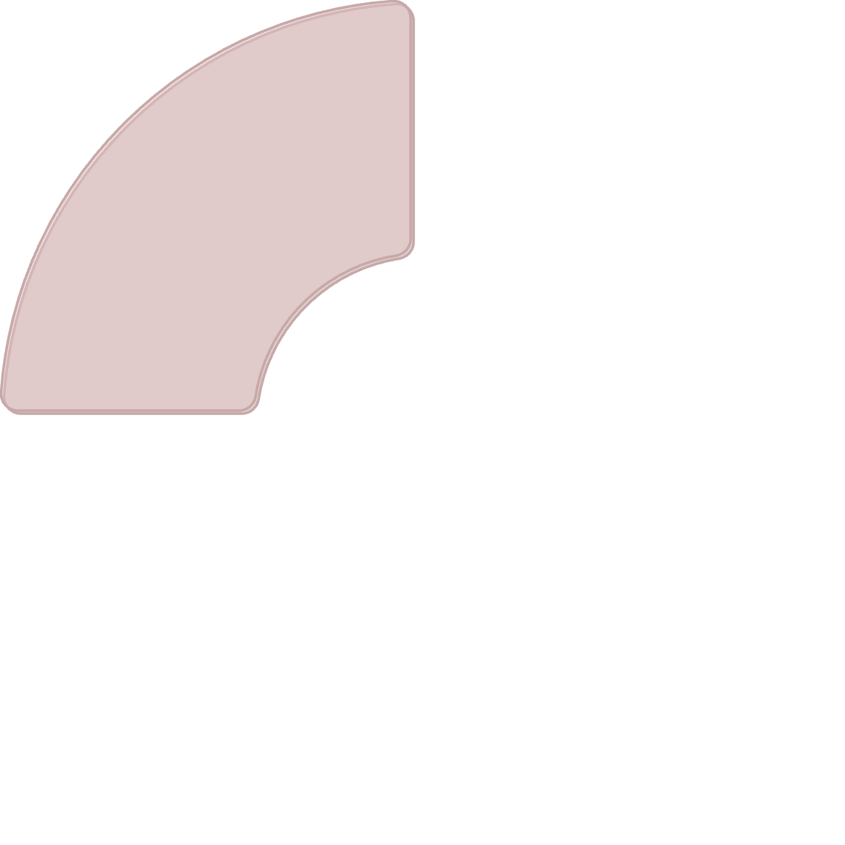







System Playback and Conclusion
Real-Time Classification
Original & Filtered Playback
The system showcases its capability for real-time noise classification, dynamically identifying and categorizing ambient sounds, which is crucial for responsive and effective noise management in live applications.
Sequential playback of both the original and adaptively filtered audio signals allows for a direct, audible comparison, unequivocally demonstrating the significant improvement in signal clarity.
DSP & Audio Processing Ready
Enhanced Signal Quality
This robust system is specifically designed and optimized for various DSP and audio processing applications, offering a versatile solution for challenging acoustic environments.
Through a synergistic application of adaptive and fixed filtering techniques, the overall signal quality is substantially improved, delivering a cleaner, more intelligible audio experience.
15

